Slide 2
Vault Boost Course

Slide 3
Overview
Architecture
Seals
Keys
Operations
Authentication
Secret Engines
Exercises

Slide 4
Typical Vault Architecture

Slide 5
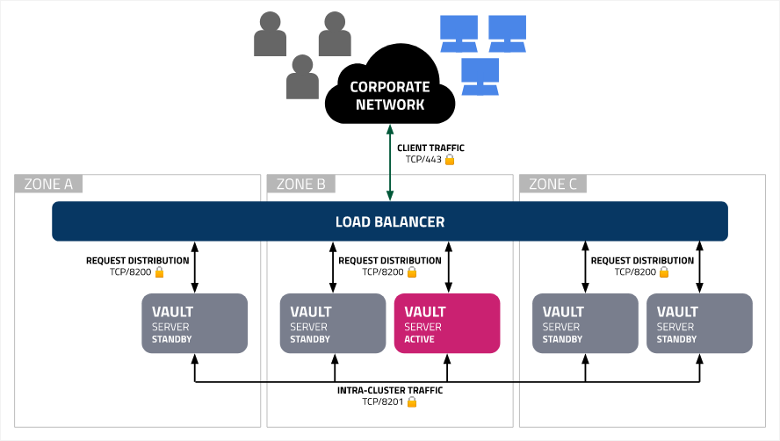
Architecture & Runtime - Raft
HashiCorp Recommendations
Raft Reference Architecture
Multi Cluster Architecture
K8s Reference Architecture

Slide 6
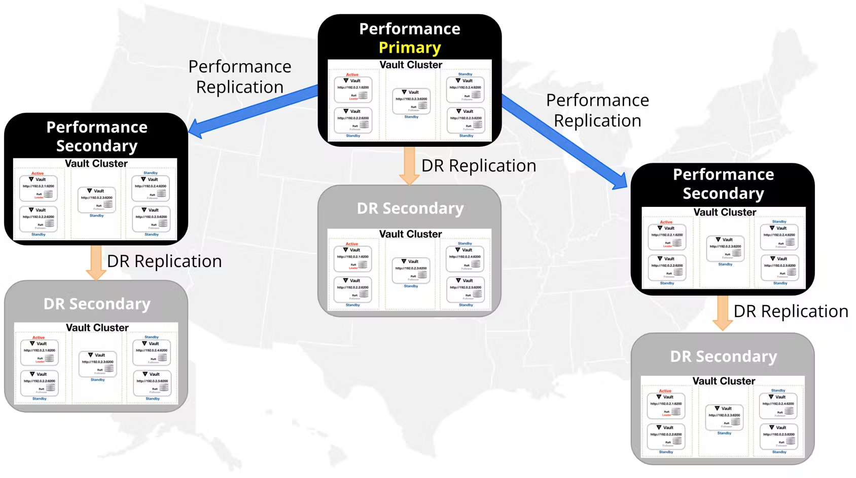
Architecture & Runtime - Replication
DR Replication is very common
Performance Replication is rare

Slide 7
Vault Seals

Slide 8
Shamir
Default option
Does not require configuration
Thresholds can be set at initialization
keys can be encrypted with pgp

Slide 9
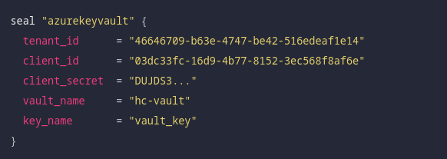
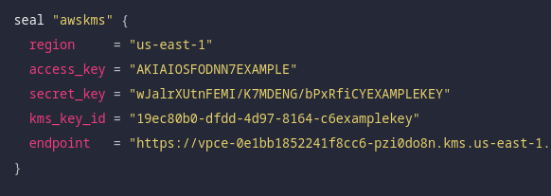
Auto Unsealing - Azure Key Vault/Aws KMS /…
requires seal stanca in vault configuration
can be configured over environment vars
be careful with secrets

Slide 10
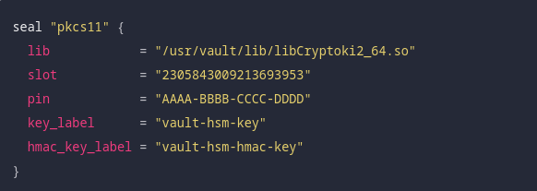
HSM
Requires PKCS11 Diver
Backup your HSM (Contact HSM Vendor)
Key Rotation
generate a new key in a different key label in the HSM
update Vault's configuration
Old keys must not be disabled or deleted!

Slide 11
Vault Keys

Slide 12
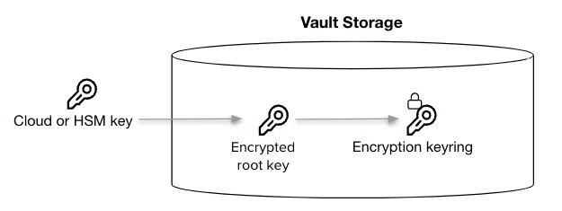
Auto-unsealing with Azure Key Vault
To perform automatic unsealing, the Shamir threshold scheme is simplified (1/1 scheme) so that 1 key is sufficient (the Azure Key Vault or cloud key) to automatically unseal the Vault cluster.
Notes:
https://www.vaultproject.io/docs/concepts/seal#seal-migration

Slide 13
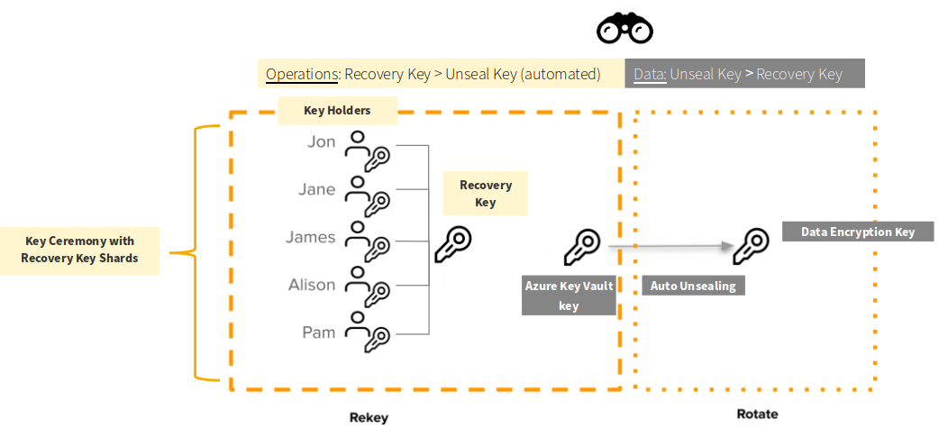
Difference between unseal/recovery key(s)​

Slide 14

Difference between unseal/recovery key(s)​
Segregation of Duties:​
Operations view: You cannot perform recovery operations with the Azure Key Vault auto unseal key​
Data based view: You cannot unseal Vault (decrypt data) with the recovery key (shards)​

Slide 15
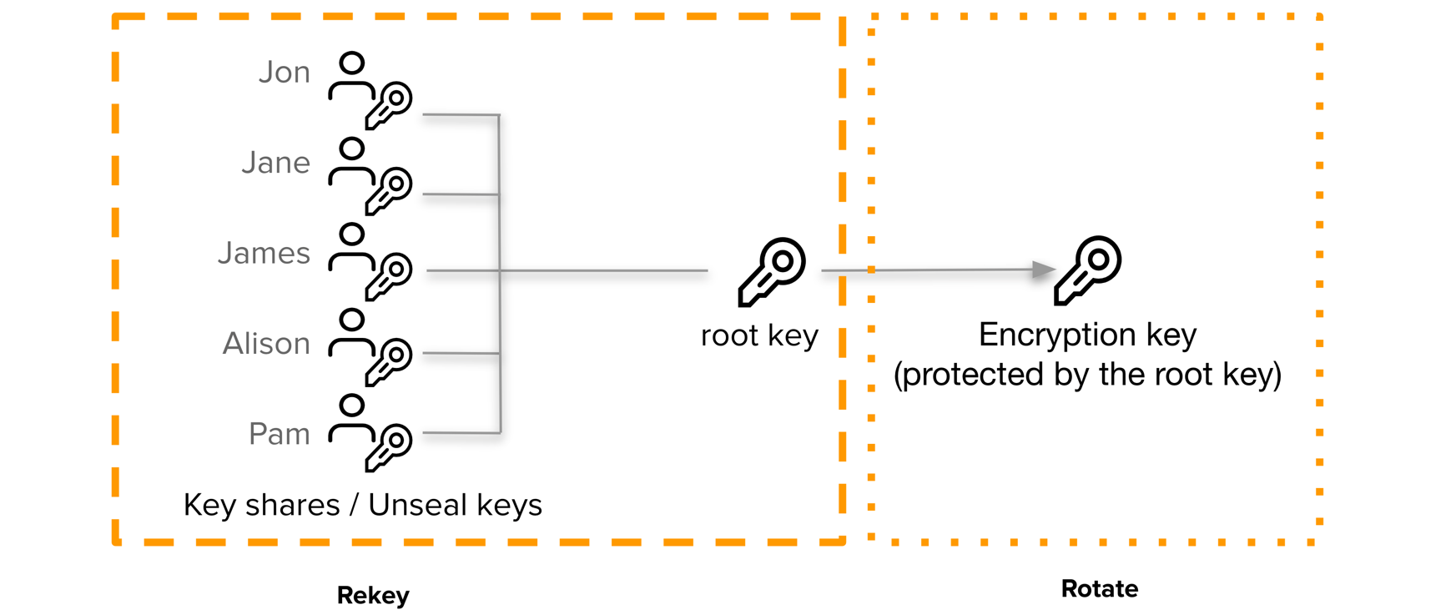
Rotation and rekeying
“Key rotation” is the procedure used to rotate the Data Encryption Key
“Rekeying” in the context of Vault refers to a change in the Shamir scheme (threshold/shares) for the unseal/recovery keys which build the “root key”.
The Azure Key Vault key for the Vault Seal can be rotated as well
Key Ceremony: Key holder assemble to agree on privileged Vault action
Recovery Keys in the case of auto-unsealing with Azure KeyVault
Notes:
https://learn.hashicorp.com/tutorials/vault/rekeying-and-rotating

Slide 16
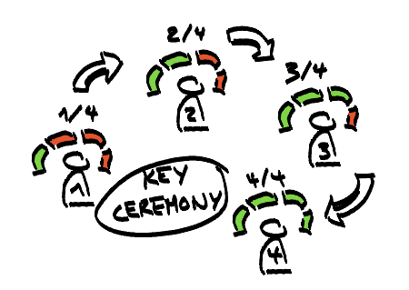
Vault key ceremony – General process​
Prerequisite​
Key holders assemble in a (virtual) room​
Input:​
Either Vault is initialized​
Or each key holder (or team) submits their key shard to the Vault service until threshold is met​​
Processing:​
The Vault service assembles the recovery key from the shards​
Output:​
In case the ceremony took place for privileged operational tasks on the Vault service, this action will be performed (e.g. root token generation)​
The new recovery key shards are returned (encrypted or plain text) in case of rekeying​ ​

Slide 17
Key ceremony - Privileged Vault operations
Recovery keys are leveraged for different privileged operations
Operation​ | Planned?​ | Frequency?​
Initialization (once)​ | ✔​ | ★​
Seal migration (e.g. from Azure Key Vault to Shamir)​ | ✔​ | ★​
Root Token generation (if needed, rare)​ | ✘​ | ★★​
Rekeying (rotation) of recovery keys (after initialization)​ | ✔​ | ★★★​
DR Token generation (for failover, rare)​ | ✘​ | ★★★​

Slide 18
Key ceremony questions
Prerequisites: What conditions must be met during the Vault initialization ceremony?​
E.g., all future key holder must be present​
Threshold scheme: How many keys will be generated and how are they protected?
E.g., 6 shards, GPG encryption​
Distribution: How are the keys distributed?​
E.g., keys encrypted with PGP keys and stored on separate USB flash drives​
Responsibility: Who is key holder and finally responsible?​
E.g., 24x7 availability for teams or single persons​
One single team (e.g., operations team)? Teams instead of individuals as key owners?​
How and where should the key be stored​
Organized storage location or up to individual key holders?

Slide 19
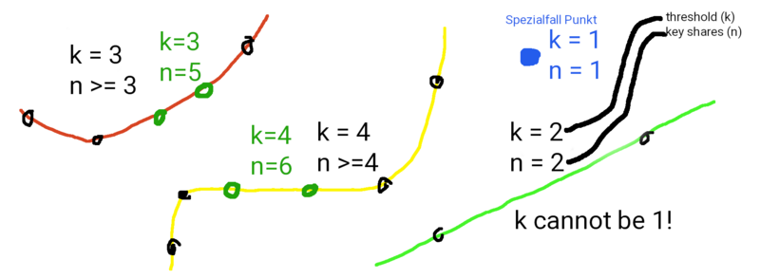
Rekeying the recovery key(s)
Assemble all current key holders to prepare the key ceremony
Decide on the new distribution of the keys
Who left the group of key holders?
Any changes in the Shamir threshold scheme required (1/1, 2/3, 3/5, k/n)?
vault operator rekey \
-init \
-target=recovery \
-key-shares=1 \
-key-threshold=1
Notes:
https://learn.hashicorp.com/tutorials/vault/rekeying-and-rotating#rekeying-vault
https://en.wikipedia.org/wiki/Shamir%27s_Secret_Sharing

Slide 20
Splitting the key in shards​
The recovery key can be split into n shards​ according to Shamir's secret sharing algorithm​
In scenario k = n, all keyholders need to be present to assemble the recovery key​
Increasing the threshold (k) enforces stricter availability requirements (24/7) for the key holders​
Given a threshold (k), increasing the shards (n) increases the resiliency of the process, since the possibility that at least (k) key owners (the threshold) are available is higher​​

Slide 21
Valid threshold schemes
Valid threshold (k) / shards (n) examples
Scheme​ (k / n) | Description​
1 / 1​ | (auto-unsealing with single key), the single point​
2 / 2​ | n = 2 points (or more) define a line (k – 1 = 1)​
2 / 3​ | n = 3 points can define a line (k – 1 = 1)​
2 / 4​ | n = 4 points can define a line (k – 1 = 1)​
3 / 3​ | n = 3 points (or more) define a polynomial of degree k – 1 = 2 ​
3 / 4 | n = 4 points can define a polynomial of degree k – 1 = 2 ​
3 / 5 | n = 5 points can define a polynomial of degree k – 1 = 2 ​
4 / 5​ | n = 5 points can define a polynomial of degree k – 1 = 3 ​

Slide 22
Invalid threshold scheme examples
1 / 2, impossible to define a point with n = 2 or more different points​
2 / 1, impossible to define a line (k – 1 = 1) with 1 point. This is a scenario where a single recovery key is shared equally (no splitting) between 2 or more people (e.g., stored in shared password safe)

Slide 23
Data encryption key rotation
Vaults internal data encryption key does not require manual “rotation”
Generally, the key is rotated automatically, just before 2³² encryptions were performed (NIST guidance 800-38D)
The key can be rotated manually (if required)
The threshold (max_operations) for the automatic key rotation can be changed
vault operator rotate
vault read sys/rotate/config
Notes:
https://learn.hashicorp.com/tutorials/vault/rekeying-and-rotating#rotating-the-encryption-key
https://learn.hashicorp.com/tutorials/vault/rekeying-and-rotating#adjusting-the-automatic-key-rotation
https://www.vaultproject.io/docs/internals/rotation#nist-rotation-guidance

Slide 24
Azure (unseal) key rotation
The Azure Key Vault Seal supports key rotation
Key can be rotated with an Azure Function App
Vault automatically detects rotate keys
env:
AZURE_CLIENT_SECRET=YOUR-APP-PASSWORD
seal "azurekeyvault" {
client_id = "YOUR-APP-ID"
tenant_id = "YOUR-AZURE-TENANT-ID"
vault_name = "Azure-vault-XXXXXX"
key_name = "key-name"
}
Notes:
https://developer.hashicorp.com/vault/docs/configuration/seal/azurekeyvault#key-rotation
https://learn.microsoft.com/en-us/azure/key-vault/secrets/tutorial-rotation-dual

Slide 25
Seal migration
Change of the Seal stanza in the Vault server configuration requires a seal migration (another type of key ceremony)
Examples:
Migration from Azure Key Vault Seal to Shamir Seal
Migration Azure Key Vault Seal to a key with a different name
Requires a complete downtime for the Vault cluster (invasive change)
Highly recommended to have a DR ready, in case the Seal Migration fails or the Seal gets damaged
vault operator unseal -migrate
Notes:
https://www.vaultproject.io/docs/concepts/seal#seal-migration

Slide 26
Vault Operations

Slide 27
Deployment - Helm and ArgoCD
HashiCorp References
Vault on Kubernetes
manually add secrets to the kubernetes cluster
configure vault in helm chart
deploy with argocd
init vault with the cli
we generally use our prepared security-apps chart

Slide 28
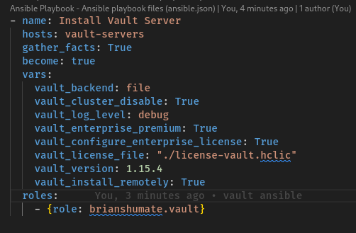
Deployment - Ansible Vault Role
HashiCorp References
Vault Ansible Role
Install Ansible
Install Role
Configure Vars
Deploy with ansible

Slide 29
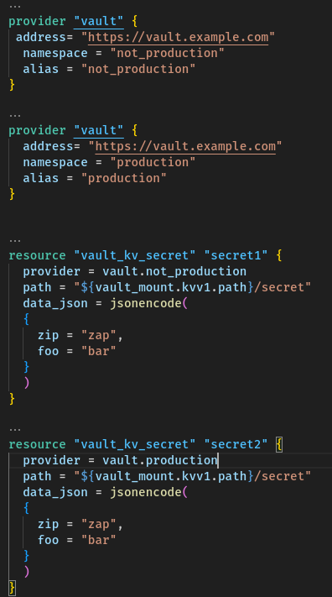
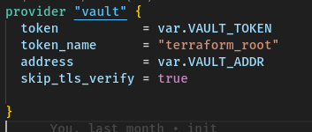
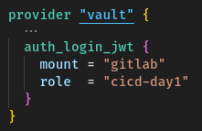

Provisioning with Terraform- Provider
HashiCorp References
Vault Terraform Provider
Vault Terraform Guide

Slide 30
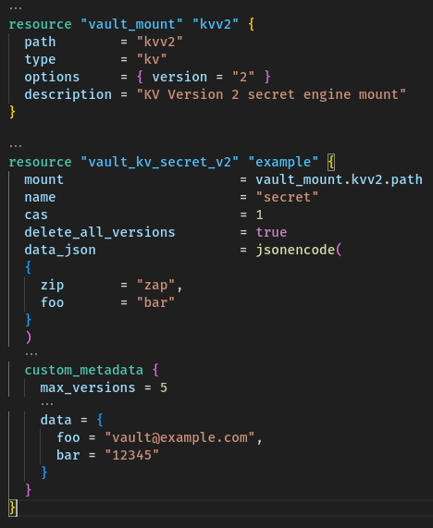
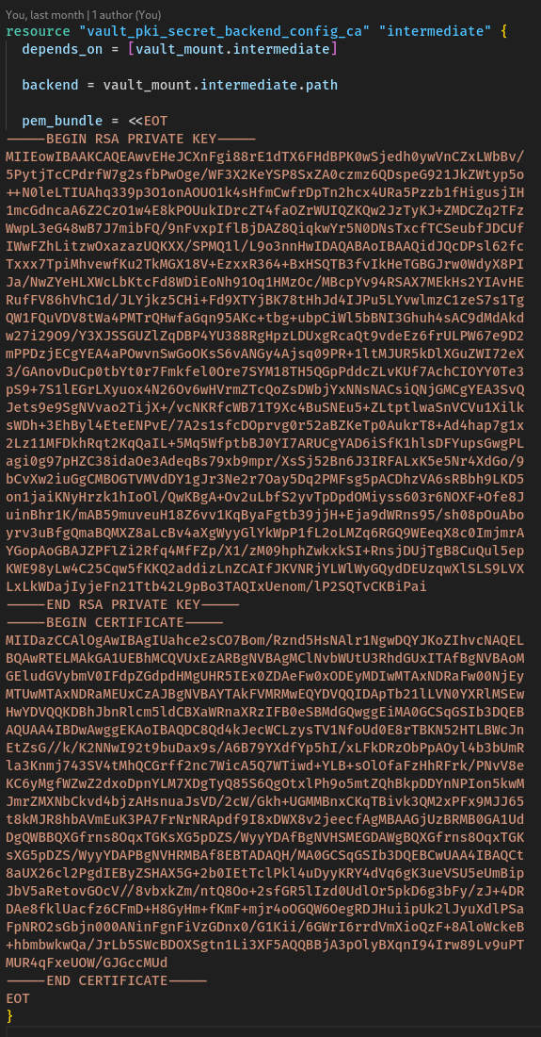
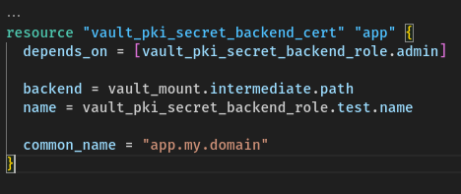
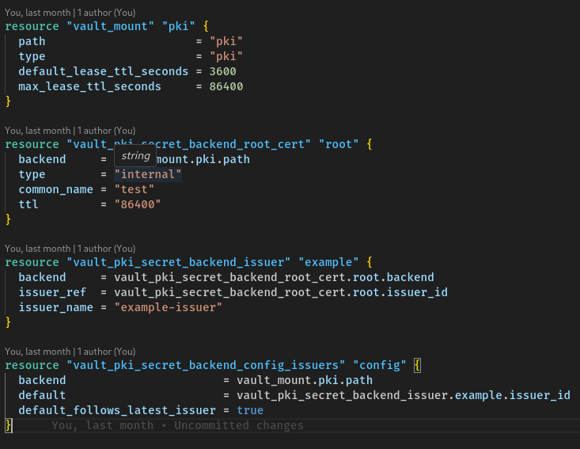
Provisioning with Terraform- Secret Engines

Slide 31
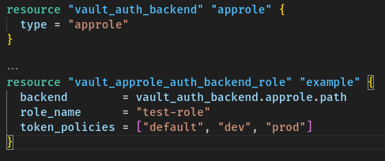
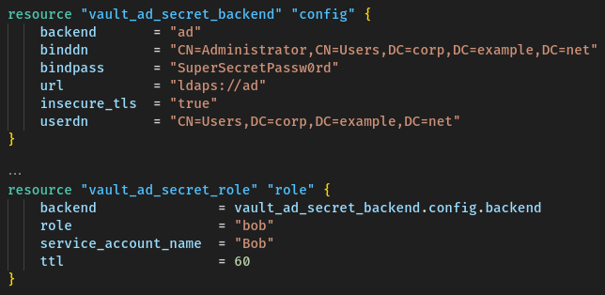
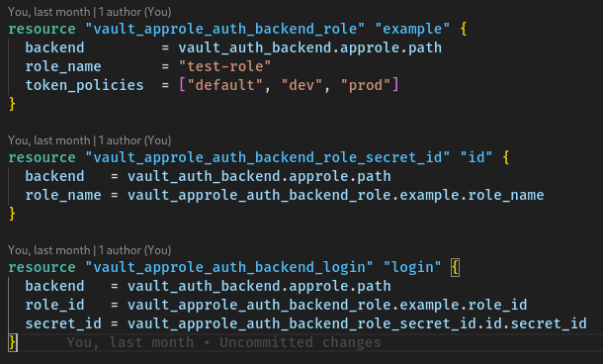
Provisioning with Terraform- Authentication

Slide 32
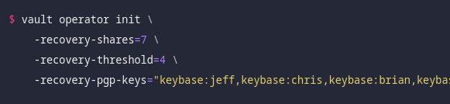
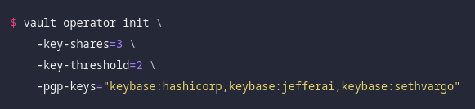
Initialization
required after deployment
once per cluster

Slide 33
Join Raft Cluster

Slide 34
Manual Unsealing
Requires Unseal Keys
Repeat until unsealed
vault operator unseal

Slide 35
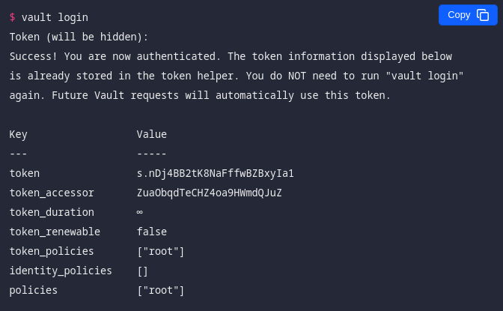
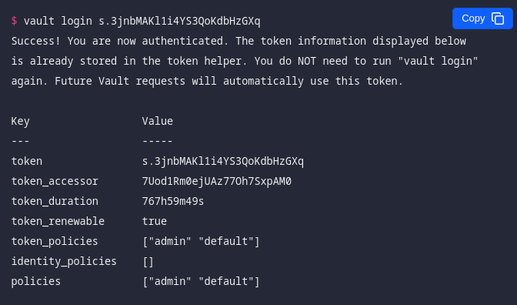
Vault CLI Login
HashiCorp References
Login

Slide 36
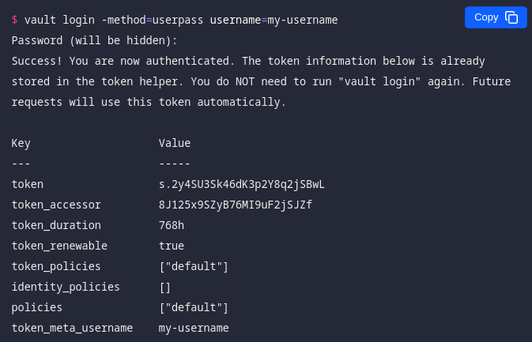
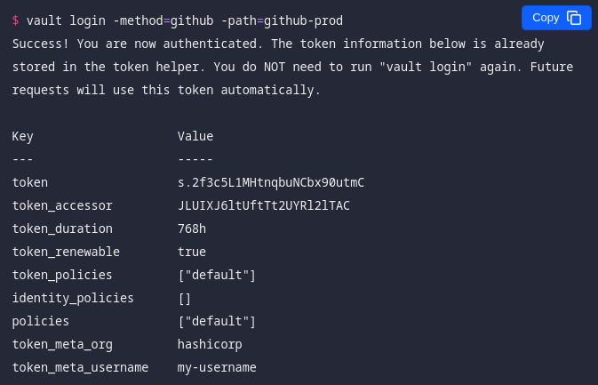
Vault CLI Login

Slide 37
Vault monitoring and alerting
HashiCorp References
Vault sys/health
Key metrics
Telemetry configuration
Adfinis Reference
Prometheus alert examples
The Vault API can be monitored with simple HTTP health check on the sys/health endpoint to get a view on the general availability
The health endpoint is not authenticated
Use CeeView to check if the API is healthy
More advanced performance metrics (i.e., is the storage backend performing well?) can be read from the sys/metrics endpoint
The metrics can be exposed in different formats (e.g., Prometheus)
Alerts and thresholds can be defined for all metrics (e.g., using Alertmanager)
vault status

Slide 38
Upgrade procedures
HashiCorp References
Upgrade guide for HA installations
Upgrade with Helm
Release notes
Verify Changelogs
Staged procedure (TEST/QUALITY/PROD)
Monitoring downtimes, inform stakeholders
Verify backup (see previous sections)
Bump version in Vault Helm chart, run Helm upgrade
Delete the Pods (StatefulSet uses OnDelete update strategy)
Check authentication and audit logging, restore monitoring

Slide 39
Generate (operation) root tokens
Generating a Root Token is a privileged operation that requires confirmation from the key holders. Thus, a key ceremony is required.
Performing a DR failovers or changes in the replication setup are also highly privileged operations. If no batch operation token is available (e.g., Token expired), creating a new DR operation token for these purposes requires a key ceremony.
vault operator generate-root
vault operator generate-root -dr-token -init
Notes:
https://learn.hashicorp.com/tutorials/vault/generate-root
https://learn.hashicorp.com/tutorials/vault/disaster-recovery

Slide 40
Rekeying the recovery key(s)
During the ceremony, all key holders supply their current (old) key shard. Once the current (old) threshold is met, the new shards are returned to the key holders and need to be distributed accordingly.
vault operator rekey -target=recovery
vault operator rekey -target=recovery -status
vault operator rekey -target=recovery -cancel
Notes:
https://www.vaultproject.io/docs/commands/operator/rekey

Slide 41
Key Rotation
normally not required (automated by vault)
vault operator rotate
vault read sys/rotate/config

Slide 42
Seal Migration
setup new unseal methode
updated/add seal stanca
restart vault
vault operator unseal -migrate

Slide 43
Raft Snapshots
HashiCorp References
Raft snapshot
Ent. Auto-Snapshot
Adfinis Reference
Kubernetes Cronjob
Vault raft data snapshots can be inspected
The Ent. auto-snapshot endpoint provides a convenient health endpoint (incl. metrics) to check the health of the snapshot schedules
Snapshots can be restored to the given point in time (RPO)
# Create a Raft snapshot
vault operator raft snapshot save raft.snap
# Inspect snapshot
vault operator raft snapshot inspect raft.snap
tar -tf raft.snap
# Restore a Raft snapshot
vault operator raft snapshot restore raft.snap

Slide 44
Authentication

Slide 45
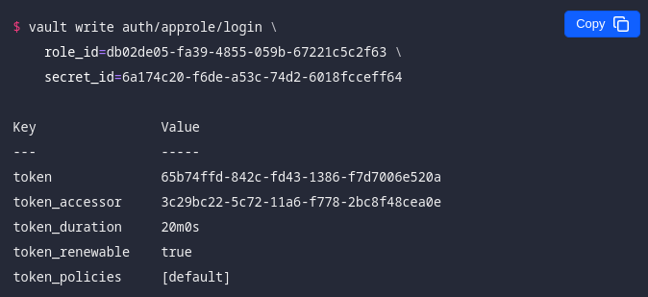
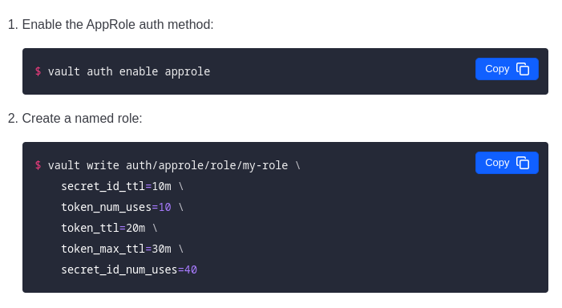
AppRole
HashiCorp References
AppRole auth method
Use Case: Machine/App Auth
is a set of Vault policies constraints that provide a token

Slide 46
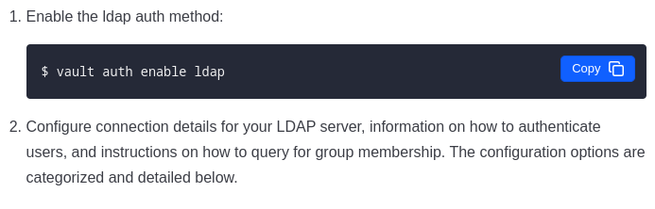
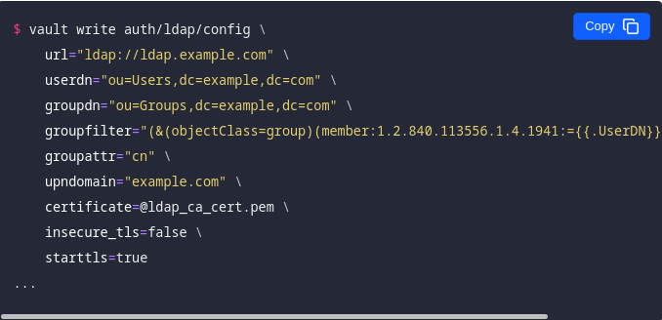
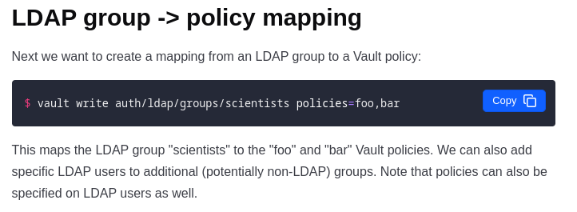
LDAP
HashiCorp References
LDAP auth method
Use Case: User Auth
Allows Group/User mapping
policy mapping happens at token creation time !!

Slide 47
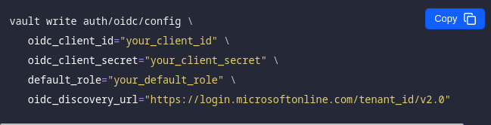
OIDC
HashiCorp References
JWT/OIDC auth method
OIDC provider configuration
Use Case: User Auth, requires Webbrowser
Specific Configuration Depends on provider
Allows for Role Mapping

Slide 48
Secrets engines

Slide 49
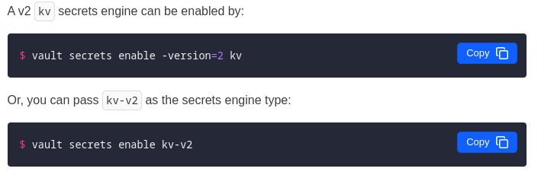
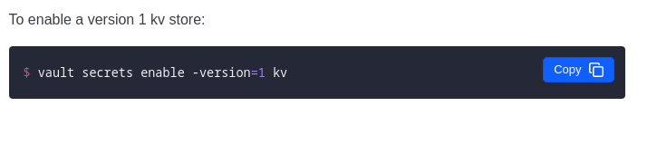
KV1/2
HashiCorp References
KV secrets engine - v 2
KV secrets engine - v 1
key value store
version 2 allows for secret history
version 2 requires additional permissions

Slide 50
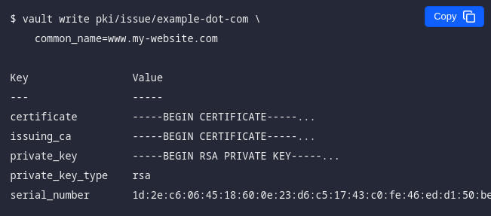
PKI
HashiCorp References
PKI secrets engine
generates dynamic X.509
Root/Sub CA can be provided
Can be backed by HSM

Slide 51

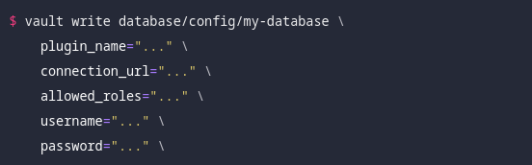
Database Secret Engine
HashiCorp References
Database secrets engine
generates dynamic database credentials
requires admin account on the db
DB specific

Slide 52
Exercises

Slide 53
Vault Boost lab
Requirements: minikube, kubectl
Clone the Repository
Follow the Setup.md guide
Solve the exercises (operations 1 - 11)
Solve the three challenges

Slide 54





Stay in Touch
/adfinis
/adfinis-com
adfinis.com
info@adfinis.com
/adfinis-sygroup

